Slide 1
Processes
Instructor: William Zheng
Email: william.zheng@digipen.edu
PHONE EXT: 1745
Notes:
1

Slide 2
Outline
“running programs” (Why inverted commas?)
What is in a Process?
A snapshot view
Context saving and restoring
Process States and PCB
Operations on process
Process Scheduling
Process Creation
Process Termination
Notes:
2

Slide 3
Snapshot view - I
Assume a process using the CPU at a point in time.
What are the “resources” that the running program would be using?
Notes:
3

Slide 4
Snapshot view - II
Process is running. So at least using Memory and CPU.
What is it using in ?
high
CPU
Memory
PC
F
SP
Stack
P
GPRs
D
Memory bus
FPRs
Heap
E
Status Flags
Data
ALU
Text
W
Control
low
Notes:
4
Program Counter – PC
Stack pointer – SP
General Purpose Register – GPR (used to calculate data and store addresses)
Floating Point Register – FPR
Arithmethic Logic Unit – ALU

Slide 5
Context of a process
User registers (including FPs, PC, SP).
Status flags and other special registers (more later)
Why registers only?
How about ALU, Control Unit and all the stuff in Memory?
Treat ALU and Control Unit like a black box
Registers are the input into ALU and Control Unit
Save the registers values and restore them later.
Same register values ensure the same behaviour from ALU and Control Unit.
Memory taken care of by OS memory management.
Notes:
5
Frame pointers – FP
Program counter – PC
Stack Pointer – SP

Slide 6
Interrupt Handling - revisited
CPU initiates I/O operation
Interrupt line
I/O device
performs
operation
CPU executes other instructions
Fetch
Decode
Execute
Writeback
Check IF Flag and priority
IF
IV
Status
Device Controller
Reg
PC
Data IN
Error or I/O complete
IF = 0
Data OUT
Set IF to 1
Control
CPU transfer controls to
Interrupt
Handler (ISR)
Instr. Reg
IF = 1
Instruction decoder
ISR runs and returns
ALU
CPU resumes running interrupted program
CPU
Notes:
6

Slide 7
HW context saving / restoring
Automatic (no instructions involved)
What if the CPU don’t support HW saving?
HW MUST support some kind of saving.
At least HW must save the PC and SP.
Too late for ISR to save PC and SP by the time ISR is running.
Where does it save to?
HW reads the SP
Save the registers to the stack.
Restoring is the reverse of saving.

Slide 8
SW context saving/restoring
Usually the 1st thing done in ISR
Sometimes HW context saving doesn’t save all the registers!
e.g., x86 only saves the GPRs but not the FPRs.
FPRs not saved unless used
SW context saving : selective vs HW saves the registers regardless whether required or not!
Notes:
8

Slide 9
System call/Interrupts Revisited
HW context saving
SW context saving
interrupt
servicing
SW context restoring
HW context restoring
system call /
interrupts
interrupt
return
kernel mode
user mode
user process
executing
this process
may not be the same one as the one interrupted.

Slide 10
Example of Virtual Memory Layout
Process-specific data structures Kernel stack
Interrupt context
User mode➔kernel mode
Kernel mode
Save on kernel mode stack for intrpt (intrpt stack)
Process context
Syscall
Save state on its kernel stack
Different for
each process
Mapping to physical memory
Kernel
virtual
memory
Identical for
each process
Kernel code & global data
0xc0000000
User Stack
%esp
Memory mapped region for shared libraries
Runtime heap
(via malloc)
Process
virtual
memory
Uninitialized data (.bss)
Initialized data (.data)
0x08048000
Program text (.text)
0
forbidden

Slide 11
x86 Interrupt
before ISR code execution
Save current stack pointer
Save current program counter
Save current processor status word (condition codes)
Switch to kernel stack; put SP, PC, PSW on stack
Switch to kernel mode
Vector through interrupt table
ISR saves registers it might clobber
Execution of handler code
Return / Restoring of process state (IRET instruction)

Slide 12
Before Interrupt
pointers: segment base+offset
Current instructions: CS+EIP
Current privilege: low-order bit of the ESP
User-level process
Registers
Kernel
Handler() {
…
}
void goo {
while(1) {
…;
}
}
SS: ESP
User stack
Interrupt
Stack
CS: EIP
EFLAGS
EAX, EBX,…
Notes:
Stack segment – SS register
ESP – 32bit of stack pointer
Code segment – CS (stores the code data of the program)
EIP – 32 bit of Instruction pointer register
CS:EIP – where next instruction to be executed in the code segment
https://datacadamia.com/computer/memory/segment/code

Slide 13
During Interrupt
User-level process
Registers
Kernel
void goo {
while(1) {
…;
}
}
Handler() {
…
}
SS: ESP
6
Interrupt Stack
User stack
5
CS: EIP
Error
4
3
EIP
EFLAGS
CS
Mask interrupts
Save to temporary HW registers (SS:ESP, Execution Flags,CS:EIP)
Switch to kernel mode
Switch onto kernel interrupt stack
Push to stack
Save error code
Invoke interrupt hander
EAX, EBX,…
EFLAGS
2
1
ESP
SS
Notes:
Mask interrupts
Save to temporary hardware registers such as SS:ESP, Execution flags, CS:EIP
Switch to kernel mode
Switch onto kernel interrupt stack
Push to stack
Save error code
Invoke interrupt handler

Slide 14
After Interrupt
User-level process
Registers
Kernel
void goo {
while(1) {
…;
}
}
Handler() {
…
}
SS: ESP
Interrupt Stack
User stack
SS, ESP,
EAX, EBX, ..
1
CS: EIP
Error
2
EFLAGS
EIP
Stack also contains saved registers
POPs all registers – restore CPU state
POP error code
IRET – Restores SS:ESP, Execution Flags, CS:EIP – returns
CS
EAX, EBX,…
1
3
EFLAGS
ESP
SS
Notes:
Interrupt Stack contains saved registers
Pop all registers – restore CPU state
Pop error code
IRET – return / restore process state (restore SS:ESP, execution flags, CS:EIP – return)

Slide 15
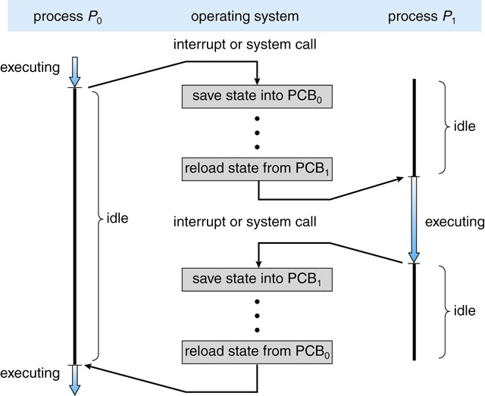
Context Switch
Notes:
PCB – process control block
PCB is a data structure that is used by computer operating system to store all information about a process. Also known as process descriptor. When a process is created or initialized, the operating system creates a process control block.

Slide 16
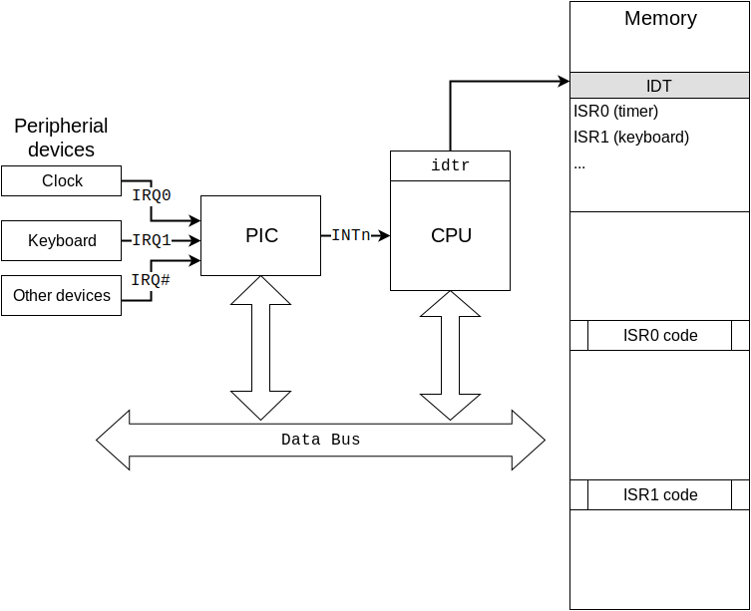
Example of Interrupt
https://alex.dzyoba.com/blog/os-interrupts/

Slide 17
ISR occurred in user mode
Temporarily saves (internally) the current contents of the SS, ESP, EFLAGS, CS and EIP registers.
Loads the segment selector and the stack pointer for the new stack (that is, the stack for the privilege level being called) from the TSS into the SS and ESP registers and switches to the new stack.
Pushes the temporarily saved SS, ESP, EFLAGS, CS, and EIP values for the interrupted procedure’s stack onto the new stack.
Pushes an error code on the new stack (if appropriate).
Loads the segment selector for the new code segment and the new instruction pointer (from the interrupt gate or trap gate) into the CS and EIP registers, respectively.
If the call is through an interrupt gate, clears the IF flag in the EFLAGS register.
Begins execution of the handler procedure at the new privilege level.
Notes:
Temporarily save contents of registers
Load segment selector and stack pointer for new stack from TSS into SS and ESP and switch to new stack
Push temporarily saved registers values onto new stack
Pushes error code onto new stack
Load segment selector for new code segment into new IP into CS and EIP register
Clears Instruction flag in the register
Execute handler procedure at new privilege level

Slide 18
ISR occurred in kernel mode
Push the current contents of the EFLAGS, CS, and EIP registers (in that order) on the stack.
Push an error code (if appropriate) on the stack.
Load the segment selector for the new code segment and the new instruction pointer (from the interrupt gate or trap gate) into the CS and EIP registers, respectively.
Clear the IF flag in the EFLAGS, if the call is through an interrupt gate.
Begin execution of the handler procedure.
Notes:
Push constents of registers on the stack
Push error code onto stack
Load segment selector for new code segment and the new instruction pointer into registers
Clear IF flag in register
Execute handler procedure.

Slide 19
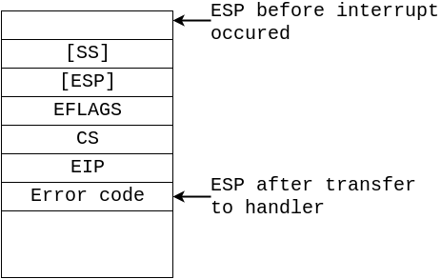
ISR Procedure
Save the state of interrupted procedure
Save previous data segment
Reload data segment registers with kernel data descriptors
Acknowledge interrupt by sending EOI to PIC
Do the work
Restore data segment
Restore the state of interrupted procedure
Enable interrupts
Exit interrupt handler with iret
Notes:
Save state of interrupted procedure
Save previous data segment
Reload data segment registers
Acknowledge interrupt
Do work
Restore data segment
Restore state of interrupted procedure
Enable interrupts
Exit interrupt handler with iret

Slide 20
Outline
“running programs” (Why inverted commas?)
What is in a Process?
A snapshot view
Context saving and restoring
Process States and PCB
Operations on process
Process Scheduling
Process Creation
Process Termination
Notes:
20

Slide 21
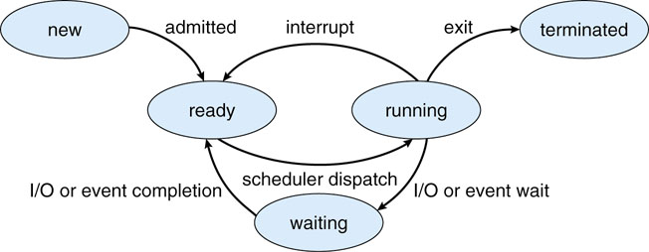
Process state transitions

Slide 22
Process state
New – Process being prepared for loading and execution.
Running – Process using the CPU.
Waiting – Process waiting for some I/O event or signal.
Ready – Process ready to run.
Terminated – Process has finished execution.
Notes:
New
Running
Waiting
Ready
Terminated

Slide 23
Process Control Block (PCB)
Data struct per process.
Maintained by OS.
Not directly accessible.
Usually a linked list.
Notes:
23

Slide 24
What is stored in PCB?
Process ID (identifier uniquely identifying the process)
Process state ( New, Running , Waiting etc)
Context (or pointer to context)
Saved here during SW context saving.
PC, SP, GPRs etc.
CPU scheduling info
Scheduling Policy / Priority
Memory management Info (learn later)
Accounting Info
I/O Status
Files opened to the process, I/O devices used in the process etc
Notes:
24
Process ID
Process state
Context
CPU scheduling info
Memory management info
Accounting Info
I/O status

Slide 25
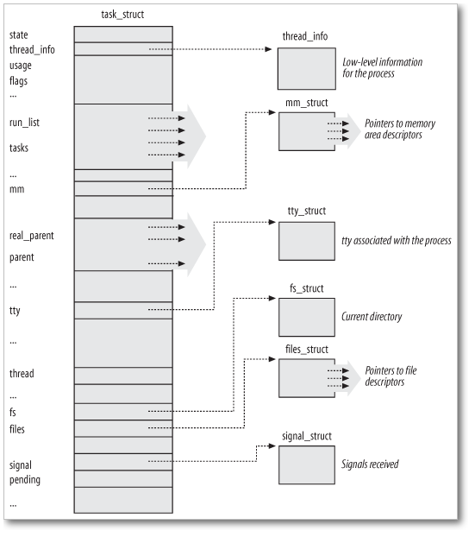
http://lxr.free-electrons.com/source/include/linux/sched.h#L1474
struct task_struct {
volatile long state; /* -1 unrunnable, 0 runnable, >0 stopped */
struct thread_info *thread_info;
atomic_t usage;
unsigned long flags; /* per process flags, defined below */
unsigned long ptrace;
int lock_depth; /* Lock depth */
int prio, static_prio;
struct list_head run_list;
prio_array_t *array;
unsigned long sleep_avg;
unsigned long long timestamp, last_ran;
int activated;
unsigned long policy;
cpumask_t cpus_allowed;
unsigned int time_slice, first_time_slice;
…
unsigned long rt_priority;
struct list_head tasks;
...
struct mm_struct *mm, *active_mm;
long exit_state;
int exit_code, exit_signal;
...
pid_t pid;
pid_t tgid;
...
uid_t uid,euid,suid,fsuid;
gid_t gid,egid,sgid,fsgid;
struct task_struct *real_parent; /*real parent process (w. debug)*/
struct task_struct *parent; /* parent process */
struct list_head children; /* list of my children */
struct list_head sibling; /* linkage in my parent's children list */
struct task_struct *group_leader; /* threadgroup leader */
Struct task_struct
Notes:
25

Slide 26
Process State Transitions
New to Ready
PCB Initialized
Memory Allocated
Ready to Running
Scheduler picked this process to run from the ready processes
You have another linked list of ready processes (ready queue)
Running to Ready
Interrupt happens. ( HW Interrupt Or Fault/Exception)
Running to Waiting
During some system calls. (Especially I/O and process synchronization)
Waiting to Ready
I/O event or Signal Process is waiting for has arrived.
Running to Terminated
When program has finished, maintain info about this process for a while. (Why?)
Notes:
26

Slide 27
Lecture Outline
“running programs” (Why inverted commas?)
What is in a Process?
A snapshot view
Context saving and restoring
Process States and PCB
Operations on process
Process Scheduling
Process Creation
Process Termination

Slide 28
Process Scheduling
Selecting n process from ready queue to run in n CPUs.
Which processes to choose?
Depends on scheduling algorithm and process attributes…

Slide 29
When is an opportunity for scheduling?
A process goes from
running to waiting
running to ready
waiting to ready*
New to ready*
running to terminated
Notes:
Between ready and waiting

Slide 30
Process scheduling
Non-preemptive
Sequential execution
Preemptive (time-shared)
Time slices/Timer Interrupt
Round-Robin scheduling
P1
P2
…
P3
Timer
int
Timer
int
Timer
int
Timer
int
Timer
int
Timer
int
sched

Slide 31
Process creation
2 things
Create a process
Loading and running a program
Linux
2 separate APIs
fork() – create process
exec() – run a new program
Windows
1 API
CreateProcess (both create process and run a new program)
Notes:
The fork() system call creates a new process without destroying the existing process. Then, the existing process becomes the parent process while the new process becomes the child process. Moreover, the exec() is also a system call that creates a new process and destroys the existing process.

Slide 32
Linux Process Creation: fork() - I
parent fork child
exact replica of parent (same memory contents, files, etc)
Different pid
Different return value for fork()
Other diff see https://linux.die.net/man/2/fork
wait() call and exit() call

Slide 33
How fork works (1)
Memory
int main(void)
{
…
int pid = fork();
…
}
high
P₁ PCB
O
S
Stack
Heap
P₁
U
S
E
R
data
PC
text
low

Slide 34
How fork works (2)
Memory
Memory
int main(void)
{
…
int pid = fork();
…
}
high
P₁ PCB
P₂ PCB
Stack
Stack
Heap
P₁
Heap
P₂
data
data
text
text
low

Slide 35
How fork works (3)
Memory
Memory
int main(void)
{
…
int pid = fork();
…
}
high
P₁ PCB
P₂ PCB
SP
Stack
SP
Stack
Heap
P₁
Heap
P₂
data
data
PC
PC
text
text
low

Slide 36
How fork works (4)
Memory
Memory
int main(void)
{
…
int pid = fork();
…
}
high
P₁ PCB
P₂ PCB
SP
Stack
SP
Stack
Heap
P₁
Heap
P₂
data
data
PC
PC
text
text
low

Slide 37
Linux Process Creation: fork() - II
#include <stdio.h>
#include <stdlib.h>
#include <unistd.h> // standard POSIX header file
#include <sys/wait.h> // POSIX header file for 'wait' function
int main(void) {
int i = -1;
int pid;
pid = getpid();
fprintf(stdout,"parent pid = %d\n",pid);
pid = fork();
if (pid == 0) {
for (i=0; i < 10; ++i) {
fprintf(stdout,"child process: %d\n",i);
sleep(1); }
exit(0);
} else {
fprintf(stdout,"child pid = %d\n",pid);
fprintf(stdout,"waiting for child\n");
wait(NULL);
fprintf(stdout,"child terminated\n");
}
fprintf(stdout,"parent terminating\n");
return 0;
}

Slide 38
fork Example: Two consecutive forks
Bye
void fork2()
{
printf("L0\n");
fork();
printf("L1\n");
fork();
printf("Bye\n");
}
printf
L1
Bye
printf
fork
printf
Bye
printf
L0
L1
Bye
forks.c
printf
fork
printf
fork
printf
Feasible output:
L0
L1
Bye
Bye
L1
Bye
Bye
Infeasible output:
L0
Bye
L1
Bye
L1
Bye
Bye
Notes:
Parent or child, which one to run first?

Slide 39
fork Example: Nested forks in parent
void fork4()
{
printf("L0\n");
if (fork() != 0) {
printf("L1\n");
if (fork() != 0) {
printf("L2\n");
}
}
printf("Bye\n");
}
Bye
Bye
printf
printf
L0
L1
L2
Bye
printf
fork
printf
fork
printf
printf
forks.c
Feasible output:
L0
L1
Bye
Bye
L2
Bye
Infeasible output:
L0
Bye
L1
Bye
Bye
L2

Slide 40
fork Example: Nested forks in children
void fork5()
{
printf("L0\n");
if (fork() == 0) {
printf("L1\n");
if (fork() == 0) {
printf("L2\n");
}
}
printf("Bye\n");
}
L2
Bye
printf
printf
L1
Bye
printf
fork
printf
L0
Bye
printf
fork
printf
Feasible output:
L0
Bye
L1
L2
Bye
Bye
Infeasible output:
L0
Bye
L1
Bye
Bye
L2
forks.c
Notes:
fork() || fork() && fork();

Slide 41
Homework – What does the following code print?
How many processes are created by this?
int main()
{
…
fork();
fork();
printf(“Hello World\n”);
…
}

Slide 42
Linux Process Creation: exec()
exec()family of functions
A function that executes a new program in the same process.
Or replace the image of a process with a new one.
Basic arguments into exec()
File that contains the new program you want to execute.
Arguments for the new program.
Optional: Environment variables for the new program.
Notes:
After running fork, want the parent or child to run a different program.
Child run new program and call using the exec() function which is to create a new program to override the whole thing except for some contents.
Environment Variables – define path

Slide 43
Different ways to pass the arguments
Filename of new program
Either using PATH environment variable
Or Full Path Name
Arguments for the new program
Either in a comma list. (NULL terminated)
Or a string array (NULL terminated)
Environment Variables
Passed in a string array.

Slide 44
Linux Process Creation: exec()
fork creates a process
How to run a new program?
exec()family of functions
Different front ends for execve()
int execve(const char *filename, char *const argv[],
char *const envp[]);
int execl(const char *path, const char *arg, ...);
int execlp(const char *file, const char *arg, ...);
int execle(const char *path, const char *arg,
..., char * const envp[]);
int execv(const char *path, char *const argv[]);
int execvp(const char *file, char *const argv[]);

Slide 45
Suffixes l, v, p and e
l | specifies that the argument pointers (arg0, arg1, ..., argn) are passed as separate arguments. Typically, the l suffix is used when you know in advance the number of arguments to be passed.
v | specifies that the argument pointers (argv[0] ..., arg[n]) are passed as an array of pointers. Typically, the v suffix is used when a variable number of arguments is to be passed.
p | specifies that the function searches for the file in those directories specified by the PATH environment variable (without the p suffix, the function searches only the current working directory). If the path parameter does not contain an explicit directory, the function searches first the current directory, then the directories set with the PATH environment variable.
e | specifies that the argument env can be passed to the child process, letting you alter the environment for the child process. Without the e suffix, child processes inherit the environment of the parent process.

Slide 46
Linux Process Creation: exec()
#include <stdio.h>
#include <unistd.h>
#include <sys/wait.h>
int main(void) {
int pid;
fprintf(stdout,"creating child process\n");
pid = fork();
if (pid == 0)
execl("/usr/games/gnome-sudoku","sudoku",NULL);
else {
fprintf(stdout,"waiting for child to terminate\n");
wait(NULL);
fprintf(stdout,"parent terminating\n");
}
return 0;
}
The first argument, by convention, should point to the filename associated with the file being executed

Slide 47
Memory
How exec works (1)
int main(void)
{
…
execl(“/bin/ls”,“ls”, NULL);
…
}
Stack
Heap
data
compiles
text
b.exe
PC
Code
Of
b.exe
Pointing to
call to execl
low
Notes:
After fork, the child process, it will run ls. Will have b.exe file when run. After

Slide 48
Memory
How exec works (2)
int main(void)
{
…
execl(“/bin/ls”,“ls”, NULL);
…
}
Stack
New
Stack,
Heap.
Data of ls
Heap
data
PC
text
Code
Of
ls.exe
low

Slide 49
Windows Process Creation
CreateProcess()
Takes in 10 arguments!
WaitForSingleObject()
WaitForMultipleObjects()

Slide 50
Example: CreateProcess
#include <iostream>
#include <windows.h>
using namespace std;
int main(void) {
STARTUPINFO start_info;
PROCESS_INFORMATION proc_info;
ZeroMemory(&start_info,sizeof(STARTUPINFO));
ZeroMemory(&proc_info,sizeof(PROCESS_INFORMATION));
cout << "creating child process" << endl;
CreateProcess("c:\\windows\\system32\\mspaint.exe",0,0,0,FALSE, 0,0,0, &start_info,&proc_info);
cout << "waiting for child to terminate" << endl;
WaitForSingleObject(proc_info.hProcess,INFINITE);
cout << "parent terminating" << endl;
CloseHandle(proc_info.hProcess);
CloseHandle(proc_info.hThread);
return 0;
}
Notes:
Create child process and override it. After creating the child process, the parent will wait for the child process to finish?

Slide 51
Multiple child processes
#include <iostream>
#include <windows.h>
using namespace std;
int main(void) {
const int COUNT = 2;
HANDLE proc[COUNT], thread[COUNT];
for (int i=0; i < COUNT; ++i) {
STARTUPINFO start_info;
PROCESS_INFORMATION proc_info;
ZeroMemory(&start_info,sizeof(STARTUPINFO));
ZeroMemory(&proc_info,sizeof(PROCESS_INFORMATION));
CreateProcess("c:\\windows\\system32\\mspaint.exe",0,0,0,FALSE,0,0,0,&start_info,&proc_info);
proc[i] = proc_info.hProcess;
thread[i] = proc_info.hThread;
}
WaitForMultipleObjects(COUNT,proc,TRUE,INFINITE);
for (int i=0; i < COUNT; ++i) {
CloseHandle(proc[i]);
CloseHandle(thread[i]);
}
return 0;
}
Notes:
Child process when create, the number of process is count. At the end when we create so many, and all the process information handle will put into proc[i] and will put into a for loop to wait for the child? Then lastly, close it by using closehandle. When we do the fork and execute.

